Slide 1

Rockbuster Stealth LLC Data Visualization
Debora Frassini
April 1st 2024

Slide 2

Rockbuster Overview
DATA
Film Collection
1000
Customers
599
Countries
109
Languages
English
Genres
20
Cities
600
Japanese
Italian
Mandarin
French
German

Slide 3


Presenting:
Top 10 Films Rented
Genres with lowest Average Rental Rate
Rating by Revenue
Top 10 most Genres in Rockbuster’s Collection
Customers and Revenue around the World

Slide 4
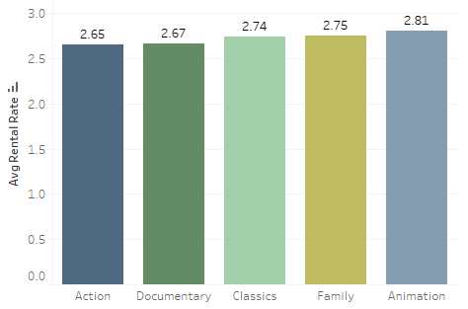
Genres with Lowest Average Rental Rate
Graphing customer rate for Genres
can improve both service provided
as well as understand the
Genre Collection

Slide 5
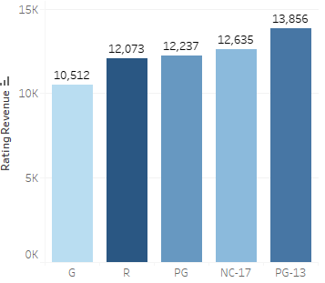
Rating by Revenue
What are Ratings?
Ratings are used to determine whether the movie is appropriate to age group.
G: General Audience
R: Restricted, under 17 requires accompanying of an adult
PG: Parent Guidance Suggested. Some material may not be suitable for children
NC-17: No one 17 and under admitted
PG-13: Parents Strongly Cautioned. Not suitable under 13 years old.

Slide 6
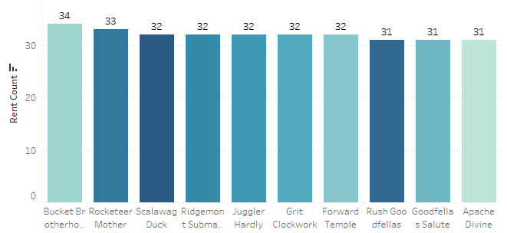
Top 10 Film Rented
Display popularity among Rockbuster’s Film Collection

Slide 7
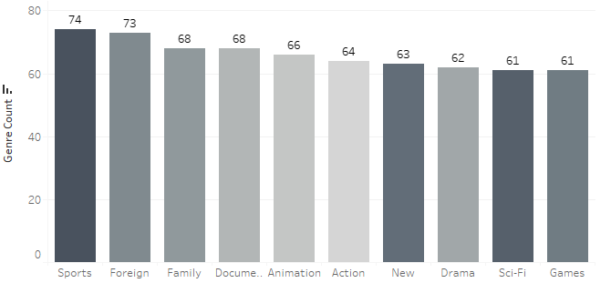
Genre with most Films in Rockbuster’s Collection
Sport and Foreign are the genres most obtained films by Rockbuster

Slide 8
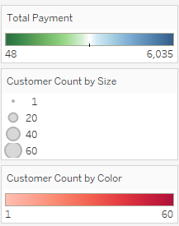
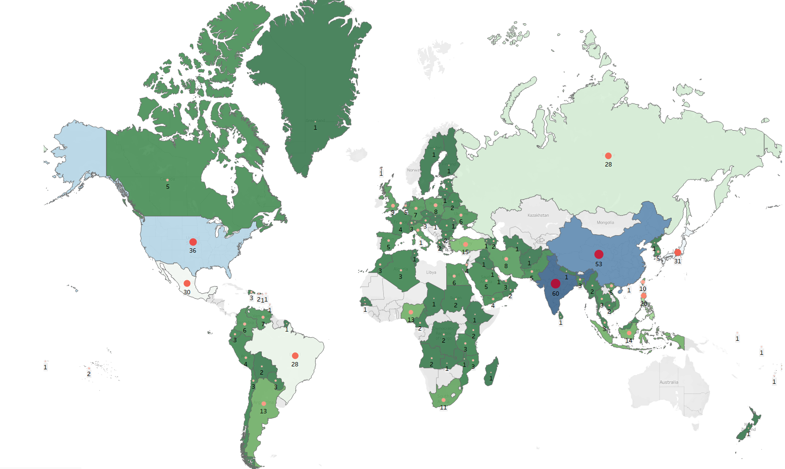
Customer and Revenue across the World

Slide 9




Recommendations
Knowing the breakdown Film Collection by Genre helps Rockbuster to diverse when acquiring more films.
Avoid acquire to the collection Films publicly rated low to the following genres: action, documentary, family, classic and animation.
Increase the G-rating Film Collection could help raise revenue for this rating.
Expand marketing strategies to countries with low number of customers and low-income revenue.

Slide 10

Questions?
For any further questions or concerns, please contact:
deborafrassini@rockbuster.com

Slide 11

Thank you

